Slide 1
Shopping Cart

Slide 2
Presentation Layer
This code is for you to use – credit where you got it from!
Shopping cart is not the order!
Imagine a person taking the order over the phone
The shopping cart represents the person taking the order
Quick Demo

Slide 3
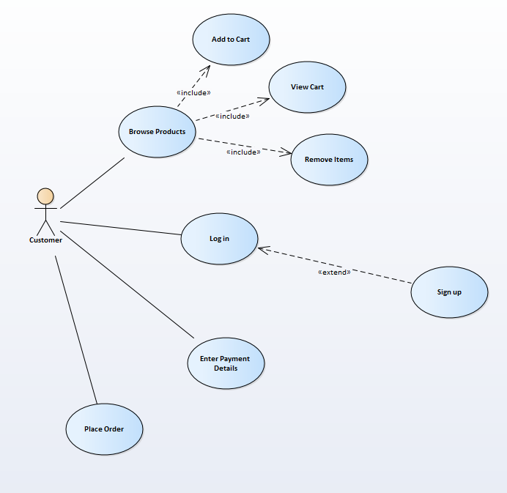
Use Case Diagram

Slide 4
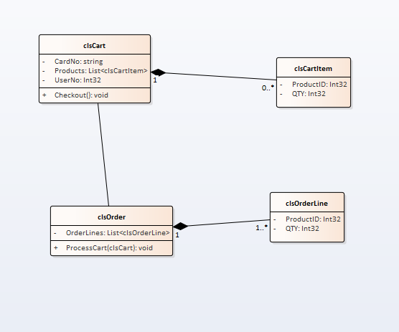
Middle Layer

Slide 5
Data Layer
From the POV of the cart there is no data layer
A tool that only exists in ram for the placing of the order
In this example we persist the class using the session object, in a real implementation it would likely use cookies, why?
Whenever we place data into the session object it sends information from client to server
Adds extra processing at the server, coupled with the data transmission slows the whole process down.
Storing the data as a cookie on the client means that the data remains only on the client machine

Slide 6
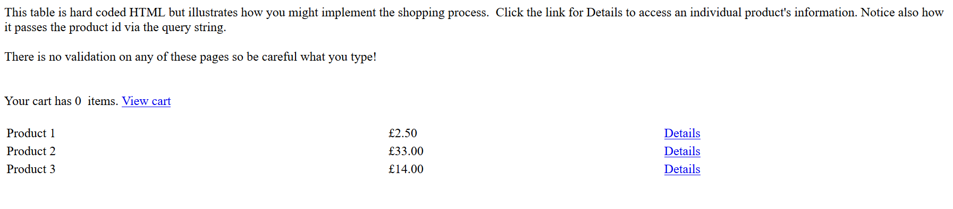
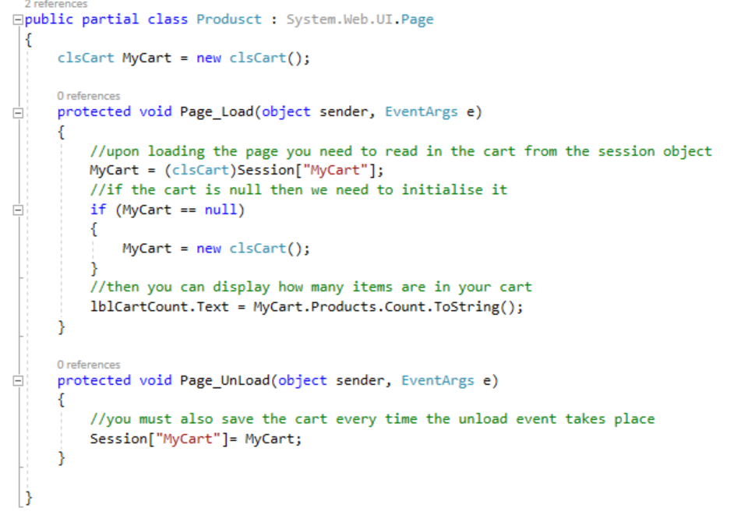
Bringing it all Together

Slide 7
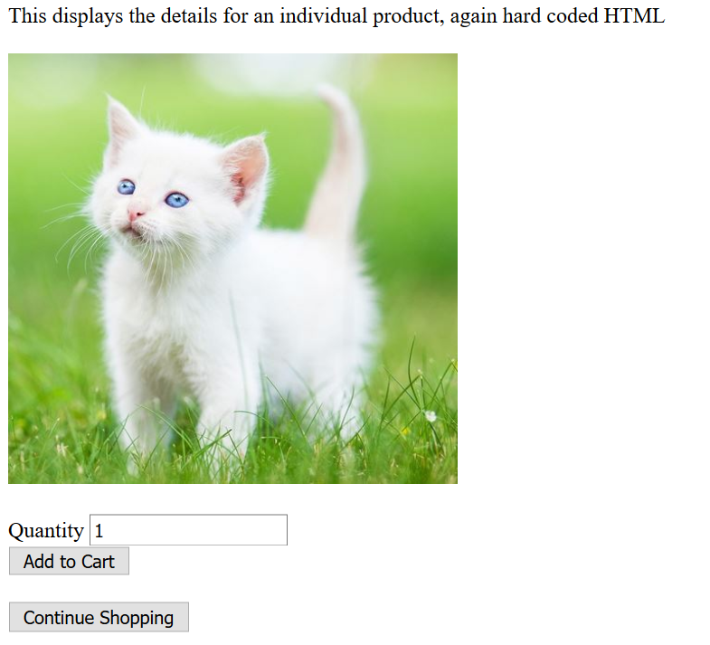
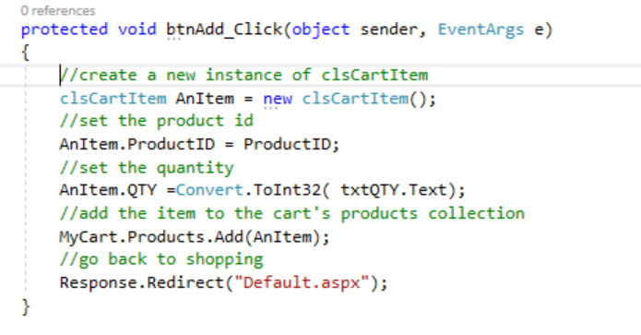
View Details

Slide 8
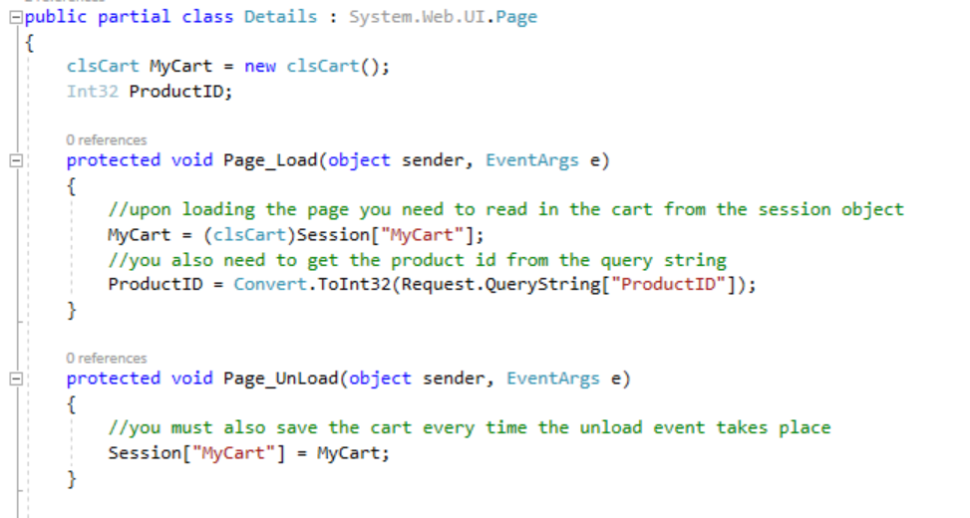
Notice Load / Unload Events

Slide 9
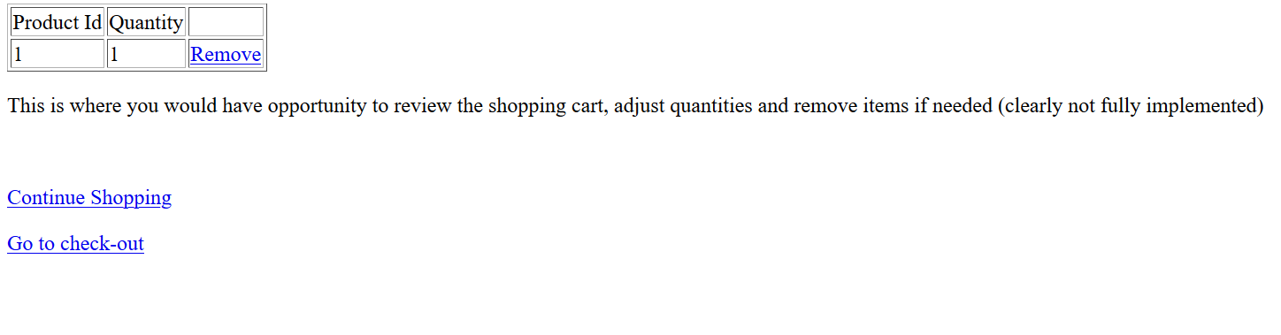
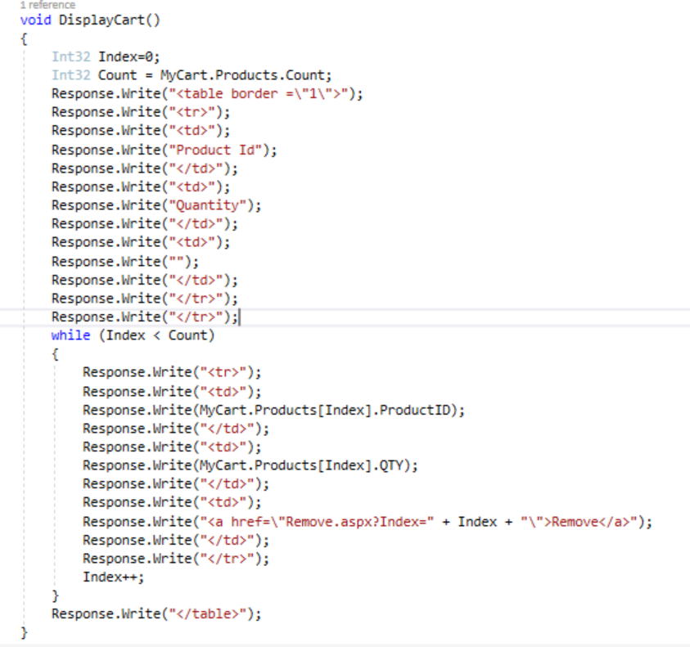
View Cart

Slide 10
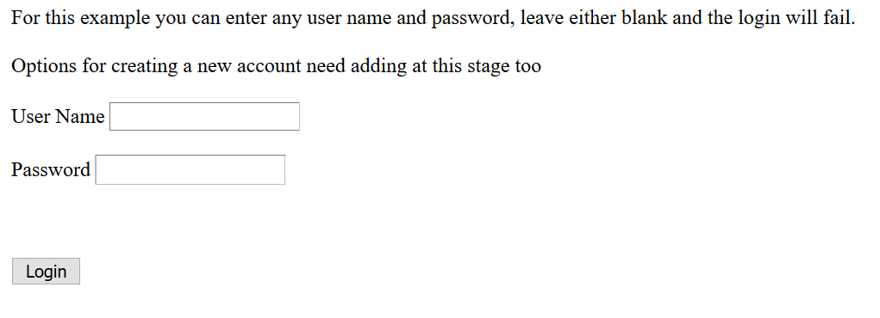
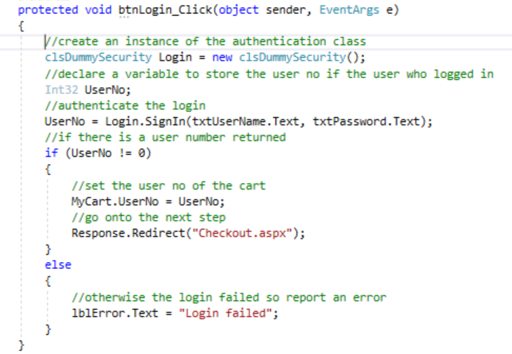
Go to check-out/Login

Slide 11
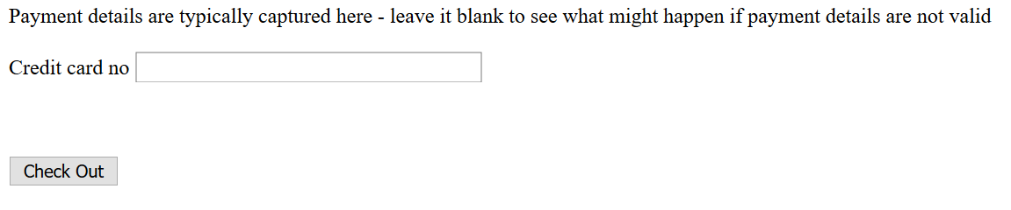
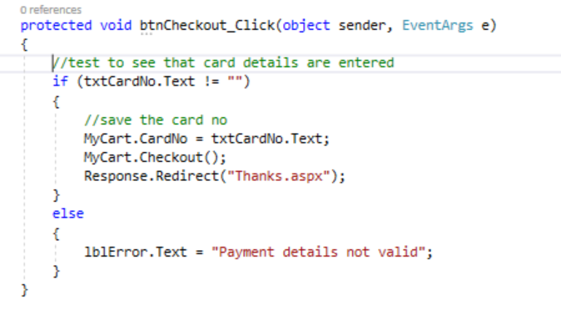
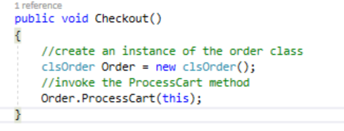
Enter Payment Details
Note – “this”

Slide 12
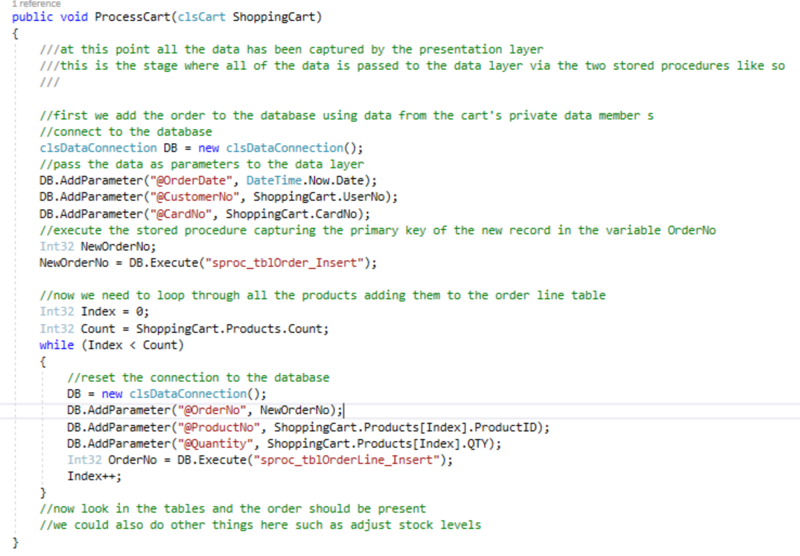
ProcessCart in clsOrder

Slide 13
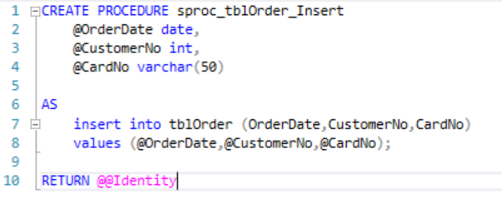
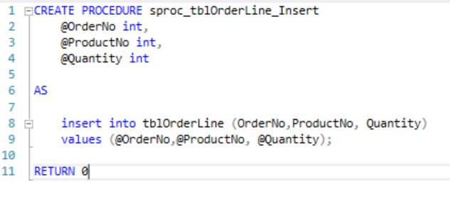
Two Stored Procedures

Slide 14
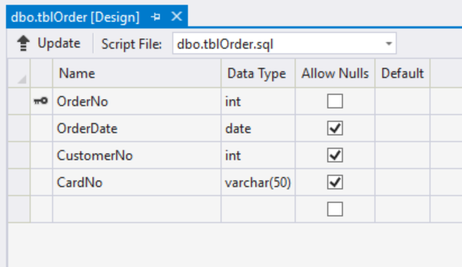
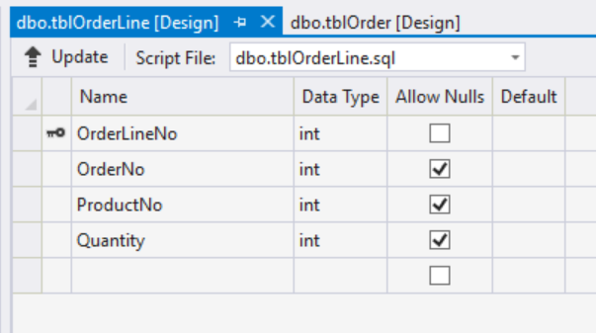
Two Tables

Slide 15
Finally
Limited implementation of a shopping cart
Plenty more to be done
There is plenty her to allow you to get the basics in place
Extend as required
Play with it
Understand the code
Bolt onto your own projects

